Slide 1
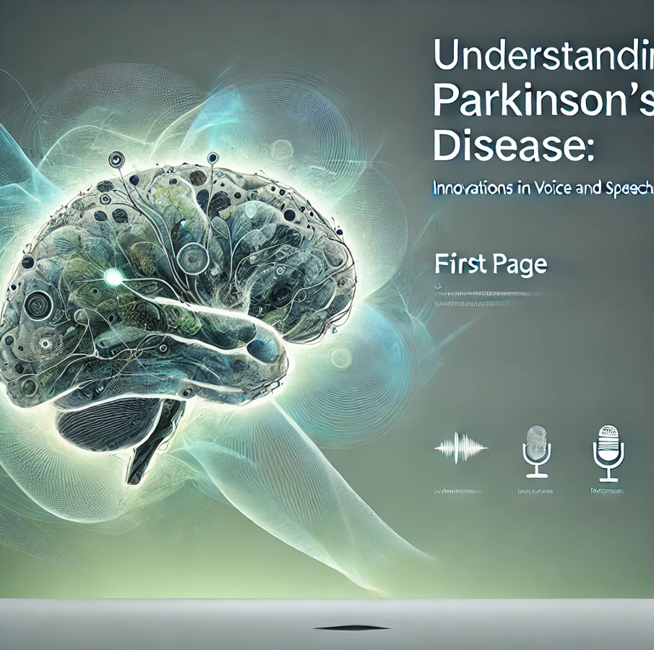
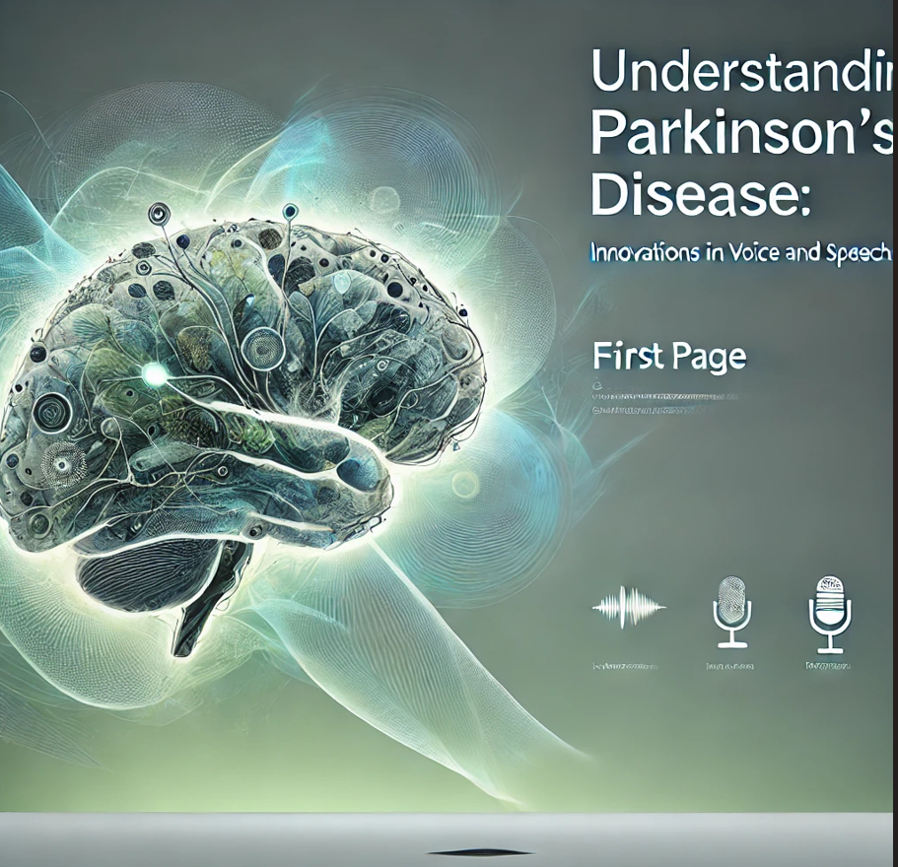
PARKINSON’S DISEASE PREDICTION USING VOICE AND SPEECH
MINI PROJECT

Slide 2

BATCH D12
PRESENTED BY:
211422104530-VARSHINI S
211422104538-VETRISELVI D
PROJECT CO-ORDINATOR:MS ABIRAMI
DOMAIN:MACHINE LEARNING

Slide 3

ABSTRACT:
This project aims to develop a non-invasive, cost-effective approach for early detection of Parkinson's disease by analyzing voice and speech patterns.Key acoustic features such as pitch, jitter, shimmer, and Mel-frequency cepstral coefficients (MFCCs) will be extracted and utilized to train machine learning models, including Support Vector Machines (SVM), Random Forests, and deep learning .Parkinson's disease causes symptoms like slower movements and shakiness, similar to aging but more severe and progressive. Early prediction helps distinguish it from normal aging, allowing for better management and slowing the disease's progression. This can greatly improve quality of life for those affected.

Slide 4

INTRODUCTION:
Parkinson’s Disease (PD) is a chronic neurological disorder that significantly affects motor control and speech, impacting millions worldwide. Early detection is vital for managing symptoms and enhancing patients' quality of life. While traditional methods often rely on voice data to identify PD, this project aims to improve prediction accuracy by incorporating both voice and advanced speech features.
By analyzing characteristics such as frequency, pitch, prosody, and articulation, we aim to capture a broader range of indicators related to the disease. This comprehensive approach is expected to provide a more precise assessment of a subject's condition.
To make the model accessible, we will develop a web-based application using Flask, allowing healthcare professionals, researchers, and patients to easily input voice and speech data. This user-friendly tool will facilitate early detection and ongoing monitoring of Parkinson’s disease symptoms, offering a practical solution for those affected.

Slide 5

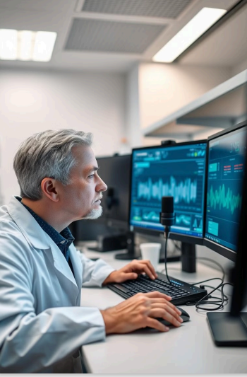
OBJECTIVE:
Develop a Non-Invasive Approach: Create a cost-effective method for early detection of Parkinson's disease.
Extract Acoustic Features: Analyze pitch, jitter, shimmer, and MFCCs from voice and speech patterns.
Train Machine Learning Models: Utilize SVM and Random Forest for classification and prediction.
Enhance Early Detection: Differentiate Parkinson's disease from normal aging for timely intervention.
Provide User-Friendly Interface: Develop an intuitive interface for healthcare professionals to easily access predictions and insights from the models, facilitating better patient management

Slide 6
PROBLEM STATEMENT:
Parkinson's Disease Impact: A progressive neurological disorder causing motor symptoms that impair quality of life.
Subtle Early Symptoms: Early signs can be mistaken for normal aging, delaying diagnosis and treatment.
Limitations of Current Methods: Existing diagnostic techniques are often invasive and costly
SOLUTION:
Analyze Voice and Speech Patterns: Extract key acoustic features like pitch, jitter, shimmer, and MFCCs for early detection.
Use SVM and Random Forest: Employ these machine learning models for accurate classification and prediction.
Enable Timely Detection: Distinguish Parkinson's disease from normal aging to improve management strategies.

Slide 7

EXISTING WORK:
Existing work typically focuses on isolated voice features, limiting the ability to capture the full range of Parkinson's symptoms.
Only focused on analyzing specific voice features affected by Parkinson’s, such as pitch, jitter, shimmer, and harmonic-to-noise ratio.
Models like Support Vector Machines (SVM) and Random Forests are commonly used to classify voice recordings as Parkinson's or non-Parkinson's based on these acoustic features. which may limit the model's ability to capture the full range of symptoms, especially in early-stage patients.

Slide 8
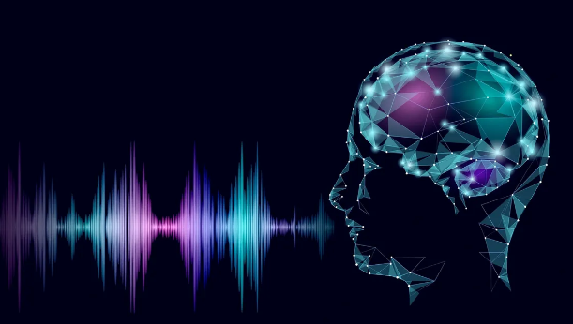
PROPSED WORK:
Aims to enhance Parkinson’s disease detection by integrating both voice and speech analysis, rather than relying solely on voice features.
This approach will analyze not only acoustic characteristics like pitch, jitter, and shimmer but also speech attributes such as articulation, speech rate, and prosody , by examining how words are formed and conveyed.
By combining voice and speech features, the model can detect a broader spectrum of symptoms, leading to more accurate predictions.
The inclusion of speech analysis helps identify subtle changes in speech patterns that may be early indicators of Parkinson’s, improving the chances of early diagnosis.

Slide 9
LITERATURE SURVEY:
"Voice and Speech Characteristics in Parkinson's Disease" (2018) by Mao et al.:
This study identifies key changes in voice and speech patterns among individuals with Parkinson's disease, focusing on alterations in pitch, speech rate, and vocal intensity as significant disease indicators. The authors suggest that these subtle changes are suitable for acoustic analysis, highlighting the potential for voice analysis as a non-invasive diagnostic tool.
2."Datasets and Methodologies for Speech Analysis" (2021) by Sapir et al.:
This study emphasizes the critical role of high-quality datasets in model training and validation. The authors advocate for the use of publicly available datasets, such as those from the UCI Machine Learning Repository, and highlight the importance of dataset diversity—accounting for variations in age, gender, and speech conditions—to improve the generalizability of predictive models.
3."Speech and Cognitive Decline in Parkinson's Disease" (2021) by Goberman and Blomgren:
This study investigates the relationship between speech disruptions and cognitive impairment in Parkinson’s disease. The authors find that speech deterioration can occur before cognitive symptoms manifest, highlighting the importance of this link for developing early diagnostic tools.

Slide 10
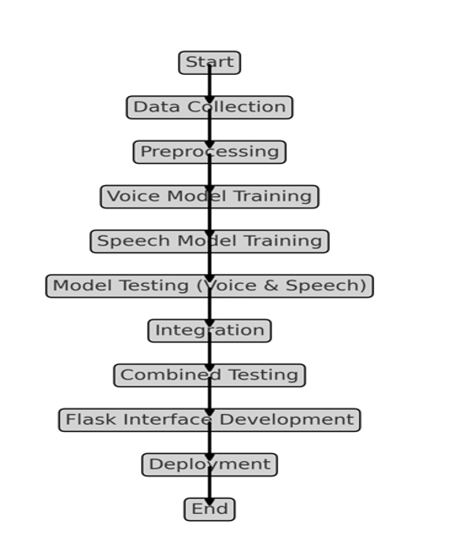
FLOW CHART:

Slide 11
METHODOLOGY:
The methodology begins with data collection, systematically gathering information from various sources, such as medical databases, patient surveys, and APIs, to create a comprehensive dataset for analysis. Following this, data preprocessing involves cleaning and formatting the raw data by removing duplicates, handling missing values, normalizing features, and creating relevant attributes specific to Parkinson's disease. Next, during model training, various algorithms are applied to the training dataset, enabling the machine learning model to learn patterns and relationships within the data for making predictions or classifications related to the disease. The process continues with model testing, where the trained model is evaluated using a separate test dataset to assess performance metrics like accuracy, precision, recall, and the model's ability to generalize to new data. Finally, a user interface (UI)is developed, combining visual elements with backend processes (e.g., using Flask), to facilitate user interaction, allowing for data input and output in a user-friendly manner.

Slide 12
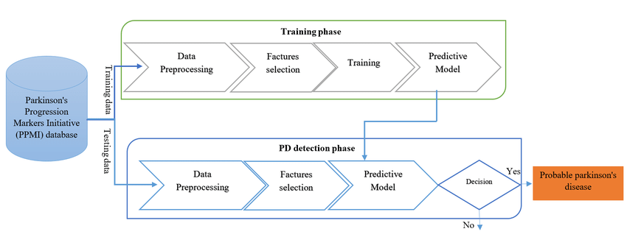
USECASE DIAGRAM:

Slide 13
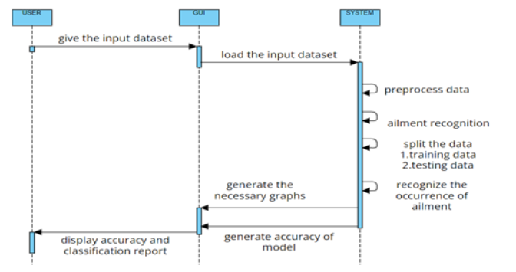
SEQUENCE DIAGRAM:

Slide 14
ADVANTAGES:
Early Detection: Changes in voice and speech can occur before motor symptoms, allowing for earlier diagnosis and intervention.
Non-invasive and Accessible: Voice analysis is a non-invasive method that can be easily conducted, making it accessible for patients with mobility issues.
Continuous Monitoring: Regular voice recordings enable ongoing assessment of disease progression, facilitating timely treatment adjustments.
Cost-effective: This approach can reduce the need for more expensive diagnostic tests, lowering overall healthcare costs.

Slide 15
DISADVANTAGES:
Variability in Speech: Individual differences in voice and speech patterns can make it challenging to establish standardized benchmarks for diagnosis.
Influence of External Factors: Factors such as anxiety, fatigue, or environmental noise can affect speech quality, potentially leading to inaccurate assessments.
Limited Scope: While voice analysis can identify specific symptoms, it may not capture all aspects of Parkinson's disease, such as non-motor symptoms or cognitive changes.
Technological Dependence: Effective implementation relies on advanced technology and algorithms, which may not be widely available or accessible in all healthcare settings.
Potential for False Positives/Negatives: There is a risk of misinterpretation of voice data, leading to false positives or negatives in diagnosis, which can affect patient care and treatment decisions.

Slide 16
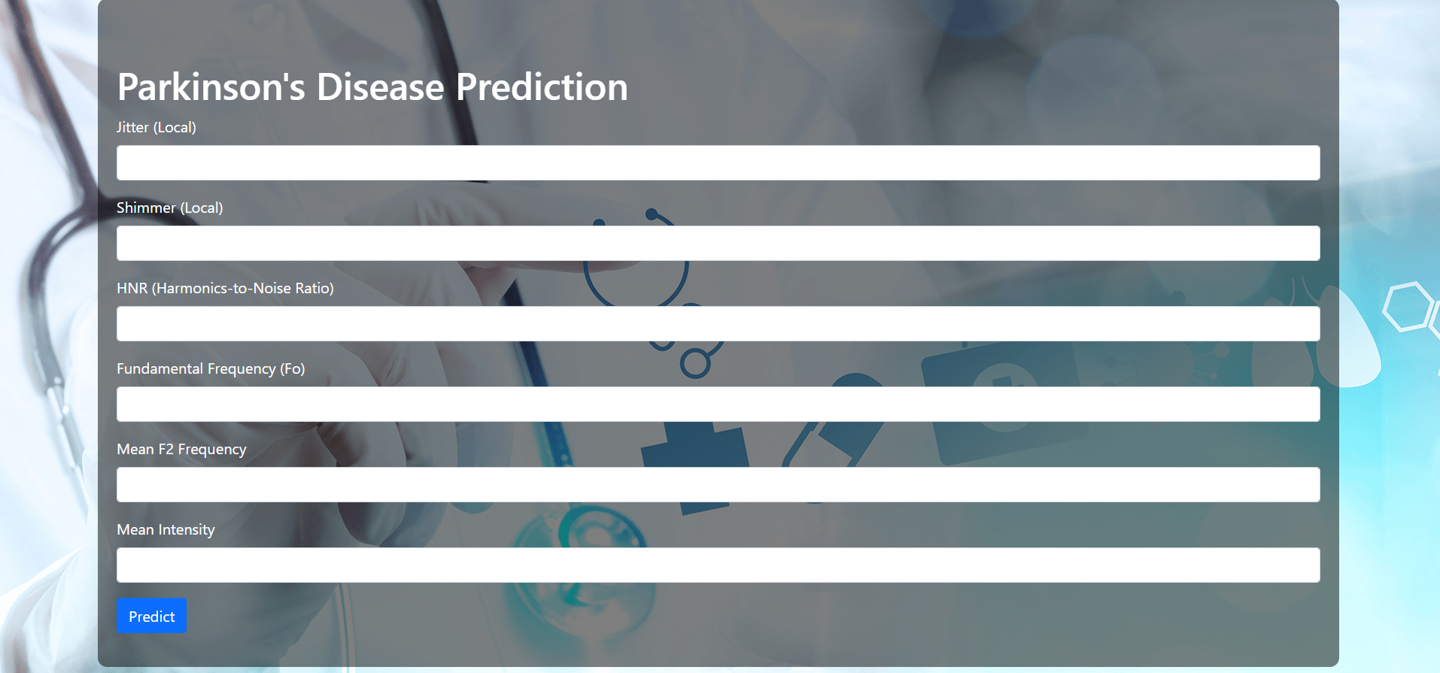
PREDICTION PAGE:

Slide 17
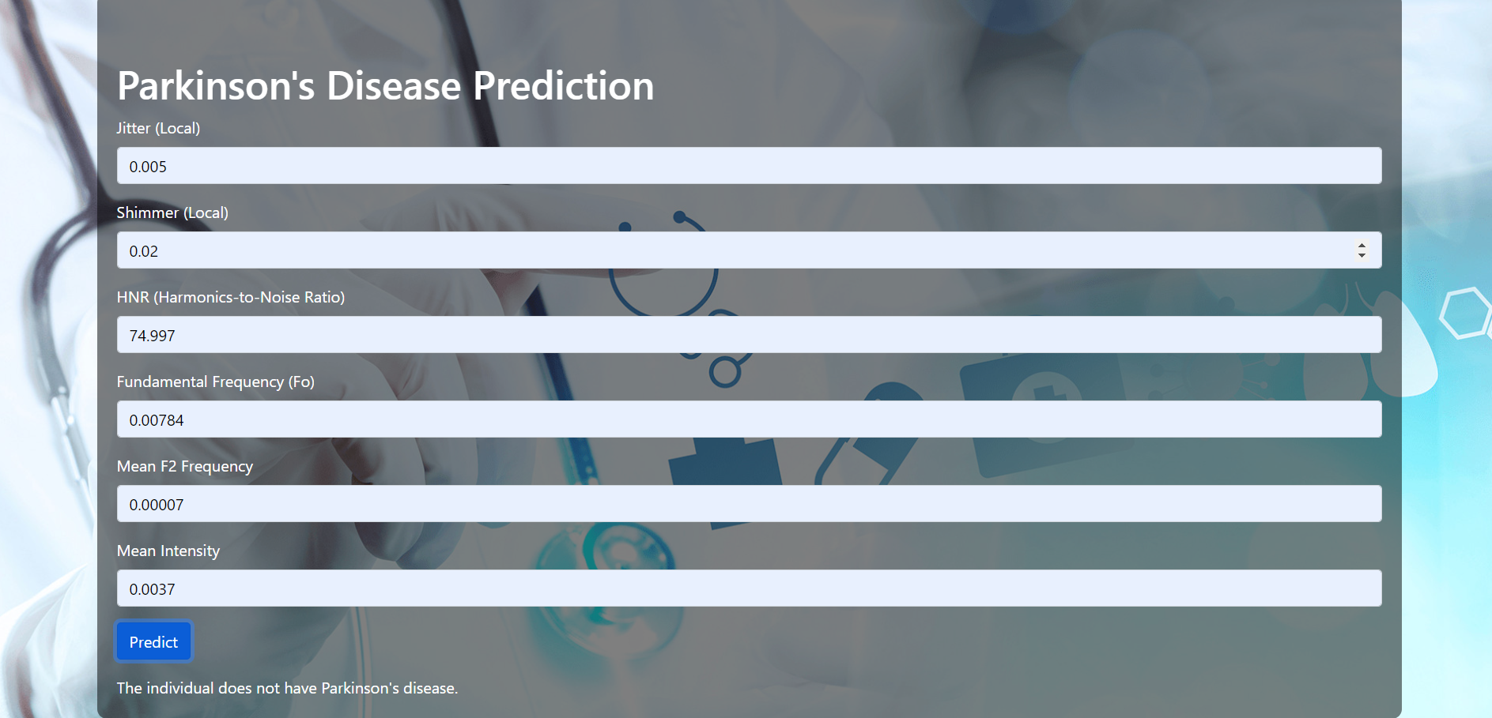
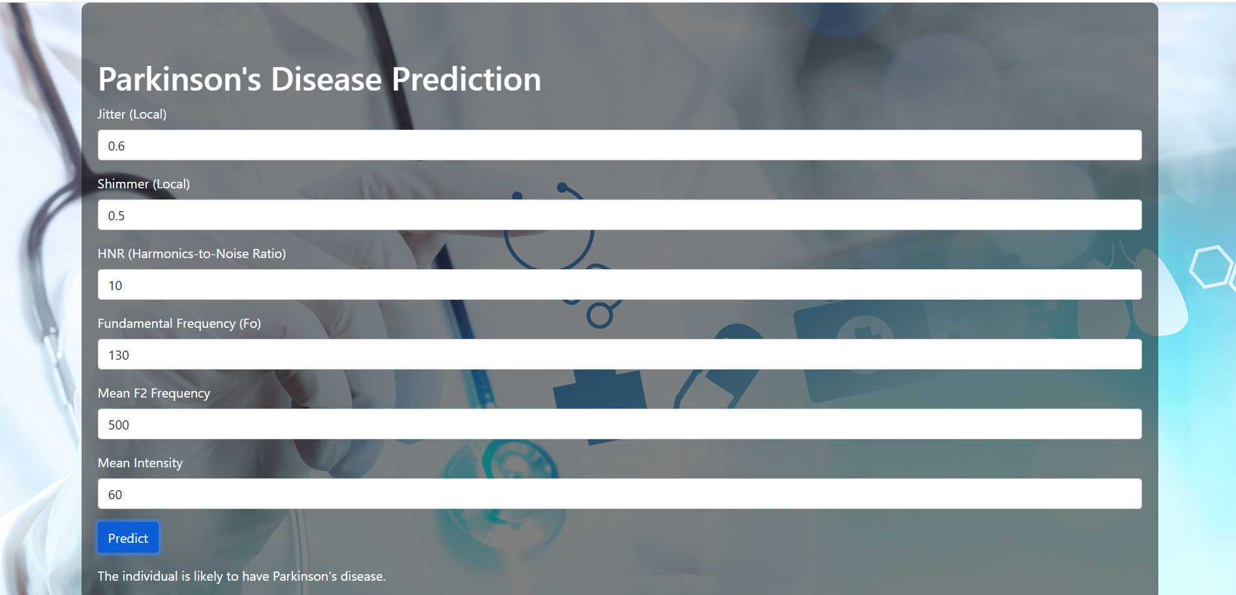
PREDICTION RESULT:

Slide 18
FUTURE ENCHANCEMENT:
Advanced AI Algorithms: Developing more sophisticated machine learning models to improve the accuracy of speech pattern analysis.
Integration with Wearable Technology: Combining voice analysis with wearables to monitor additional physiological signals for a comprehensive assessment.
Personalized Baselines: Establishing individualized baseline measurements to enhance diagnostic precision and account for natural speech variability.
User-friendly Applications: Creating mobile or web apps for easy patient engagement in recording and analyzing their voice regularly.

Slide 19
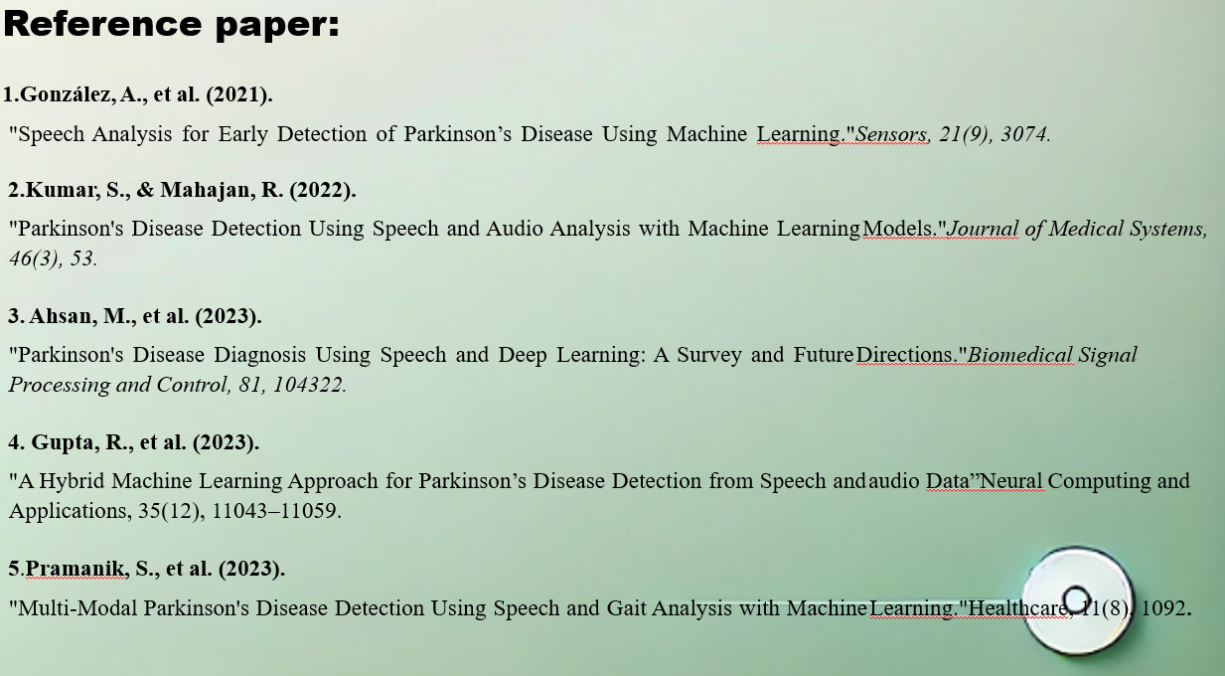

Slide 20
THANK YOU

